Slide 1
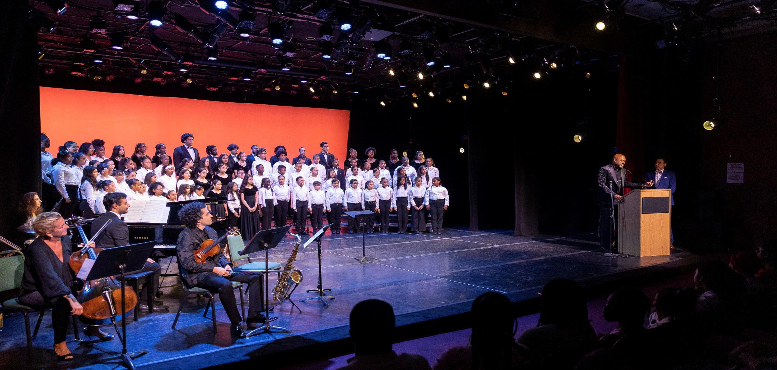

A Pathway to Success

Slide 2
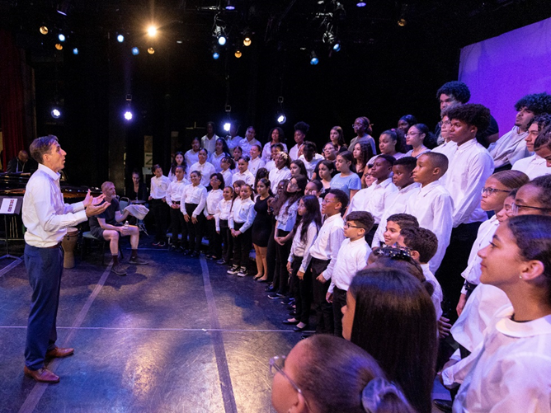
Strategic Overview
  FOUR PILLARS OF SUCCESS
  1st Class Music and Choral Education
  A “Safe Place” to grow and thrive after school
  Significant Academic support and enrichment
  Pathway to our “Performance Choir”
        A Proven pathway to success for young people in Highbridge
        Extraordinary Concerts (e.g. Jazz at Lincoln Center, St. Jean Baptiste, Mosaic)
        Renewed Vision and Relationship with Sacred Heart School and Parish
        Community partnership building (e.g. Grand Street Settlement)

Slide 3
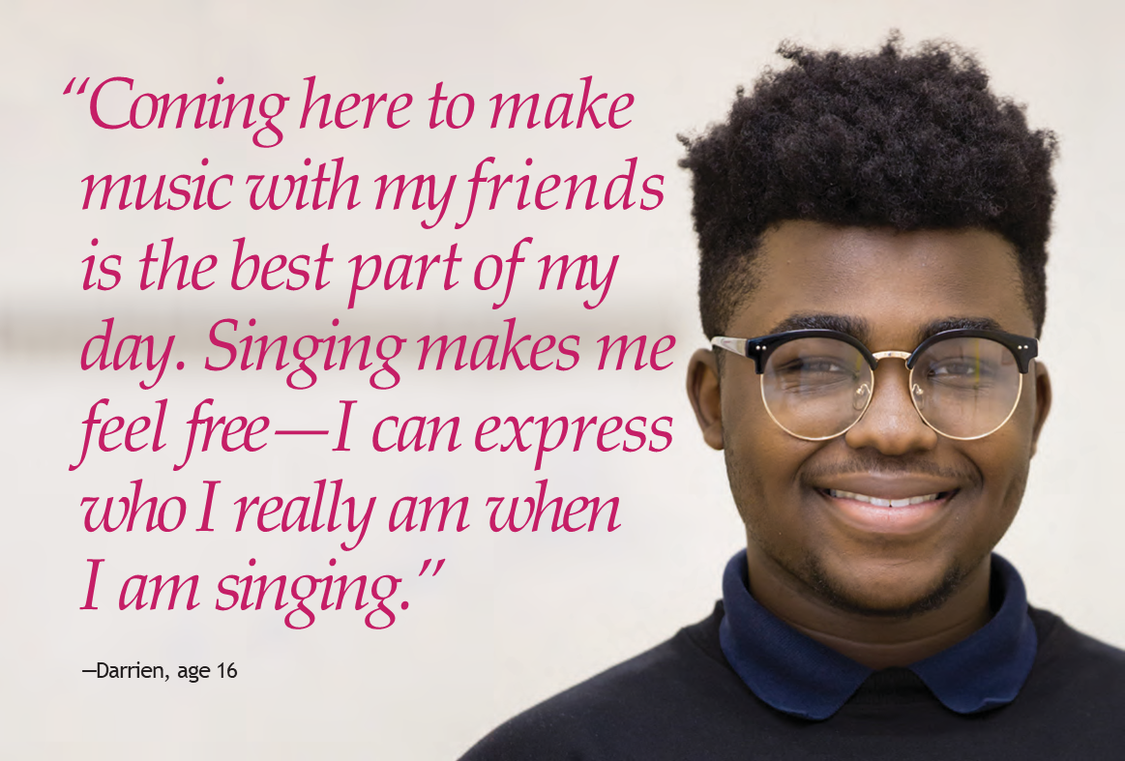

Slide 4
2025-26 GOALS
Recruit and Develop a 250 member CORE group utilizing HBV proven “Method”
FOCUS ON KEY LOCATIONS & PARTNERSHIPS
Merriam Avenue: 50 STUDENTS - HBV Staff 5x a week (tutoring, counseling, academic enrichment, music, performance)
Sacred Heart School (After School Music Program): 50 STUDENTS - HBV Staff 3x a week (tutoring, counseling, music)
Sacred Heart Parish (After School Program): 50 Students
Green School: 50 STUDENTS - HBV Staff 3x week (Music instruction)
Grand Street Settlement at Artsbridge (Pre-school Music Program): 50 STUDENTS

Slide 5

25 Years of Proof of the HBV Method
98%
95%
97%
92%
79%
70%
District 9
District 9
98% of HBV graduates complete high school in 4 years compared to 70% in the Bronx’s District 9.
2011 – 2019 Data Study
92% of Highbridge students are passing English language arts; 95% are passing math.
Highbridge Voices students’ average school attendance is 97% compared to 79% in the Bronx’s District 9.
            Leading to significantly improved high school graduation rates
            Musical and choral education
            A safe place to be after school
            Academic support through Fordham University and Barnett Foundation
            Opportunity to participate in high quality “performing choir”

Slide 6
2025-26 OPERATING PLAN OVERVIEW
Leverage infrastructure of Sacred Heart School, Sacred Heart Parish & Grand Street
Recruit youth to participate in “Performance choir” from all HBV Locations
Maintain core community and public school outreach at select focused locations
Programming Committee (Abigail Akano) & Music Recommendations (Michelle Trinidad)
Leveraging of Sacred Heart School and Parish physical facilities
Deeper Involvement of Richard Owen: New staffing and engagement structure
Development of sustainable programing and funding sources
Identify Grant writer
Creative fundraising strategies & new board member cultivation
Expansion of relationship with Fordham University

Slide 7

YOUR SUPPORT IS IMPORTANT
Highbridge Voices students outpace their peers in school performance thanks to a robust academic program that encourages critical thinking, curiosity, and problem solving. From fourth grade
math enrichment to high school SAT prep, Highbridge Voices students are propelled on their academic journey every step of the way..
With music excellence being the cornerstone to building self confidence.

Slide 8
FINANCIAL SNAPSHOT – 2023-2024
EXPENSES
5 STAFF MEMBERS: 1 FULL TIME + 4 (1099 CONTRACTORS)
MONTHLY EXPENSE - $20K
OFFICE EXPENSES: INTERNET, PHONE, SUPPLIES
MONTHLY EXPENSE - $2.5K
INSURANCE (HEALTH, UMBRELLA, LIABILITY)
ANNUAL TOTAL EXPENSE - $25K
PERFORMANCE EXPENSES: VENUE RENTAL, ARTISTS FEES, CATERING
ANNUAL TOTAL EXPENSE - $50K
CURRENT TOTAL ANNUAL EXPENSES - $345K
REVENUE
INDIVIDUAL GIVING: $105K
PUBLIC GRANTS: $25K
PRIVATE FOUNDATIONS: $120K
      CURRENT TOTAL ANNUAL REVENUE - $250K

Slide 9
FUNDRAISING GOALS/ENDOWMENT
ENDOWMENT: Highbridge voices is embarking on an ambitious fundraising campaign to solidify our future and impact on the Highbridge community for many years to come. Through a combination of board participation, grant applications and public funding, we intend to raise upwards of $3,000,000 in the next 12-18 months.
CURRENT EXPENSE: is approximately $30k/monthly and our current reserve fund is almost depleted. We are asking for your immediate assistance in order for us to continue elevating the Highbridge Community and secure our future.
PLEASE DONATE NOW
If you would like to make a donation by mail, please make all checks payable to:
Highbridge Voices
C/o Highbridge Community Development Corporation
1465 Nelson Avenue, Ste A Bronx NY 10452
Attn: Krystal Morel

